Slide 1
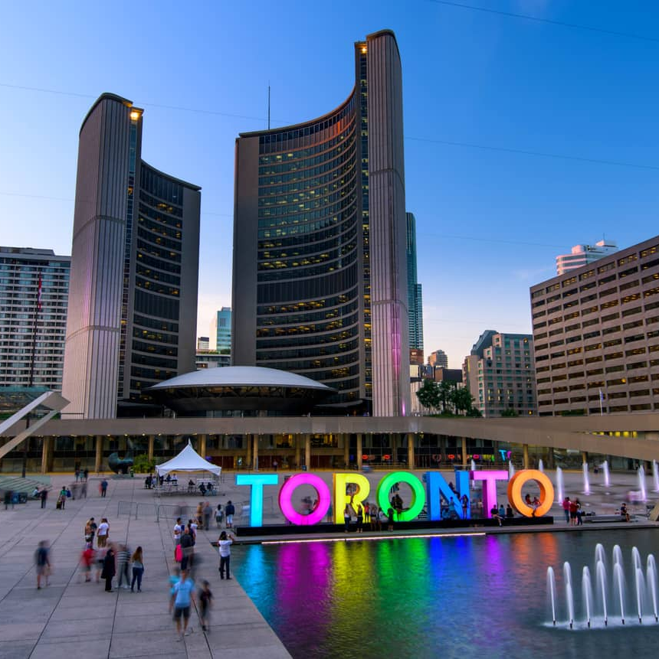
The Battle of neighborhoods
Segmentation and clustering of neighborhoods in Toronto

Slide 2
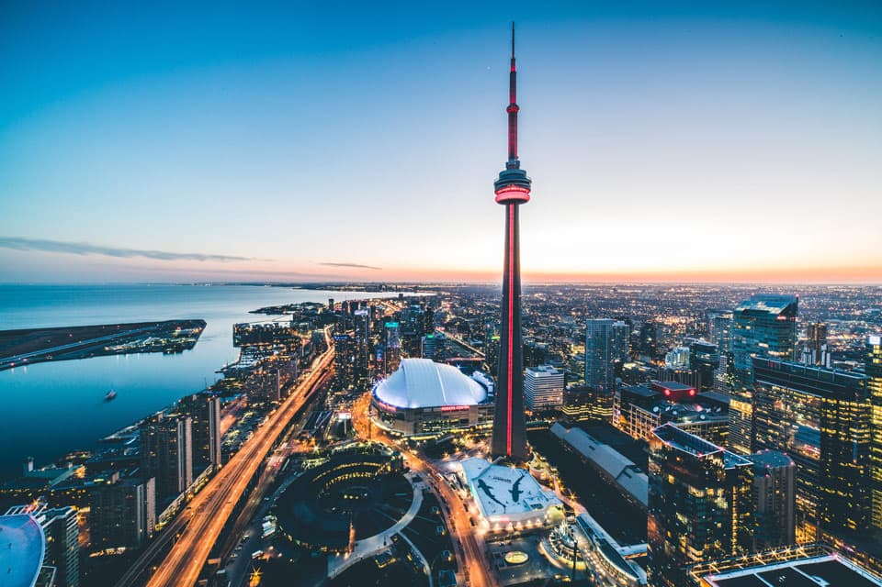
introduction
This data science capstone project is for IBM Data science professional certificate. In this project I am creating a hypothetical situation for a concept that there may not be enough Indian restaurants in Toronto. So it might be a great opportunity for a entrepreneur living in that area

Slide 3
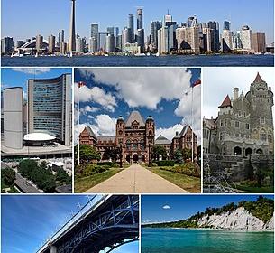
Business problem
The Objective of this project is to find the best location for this entrepreneur to open a Indian restaurant in Toronto, Canada. With the help data science methods and tools along with machine learning algorithm like clustering and foursquare API, this project aims to find the most suitable location to open a Indian restaurant where most of the Asian community resides

Slide 4
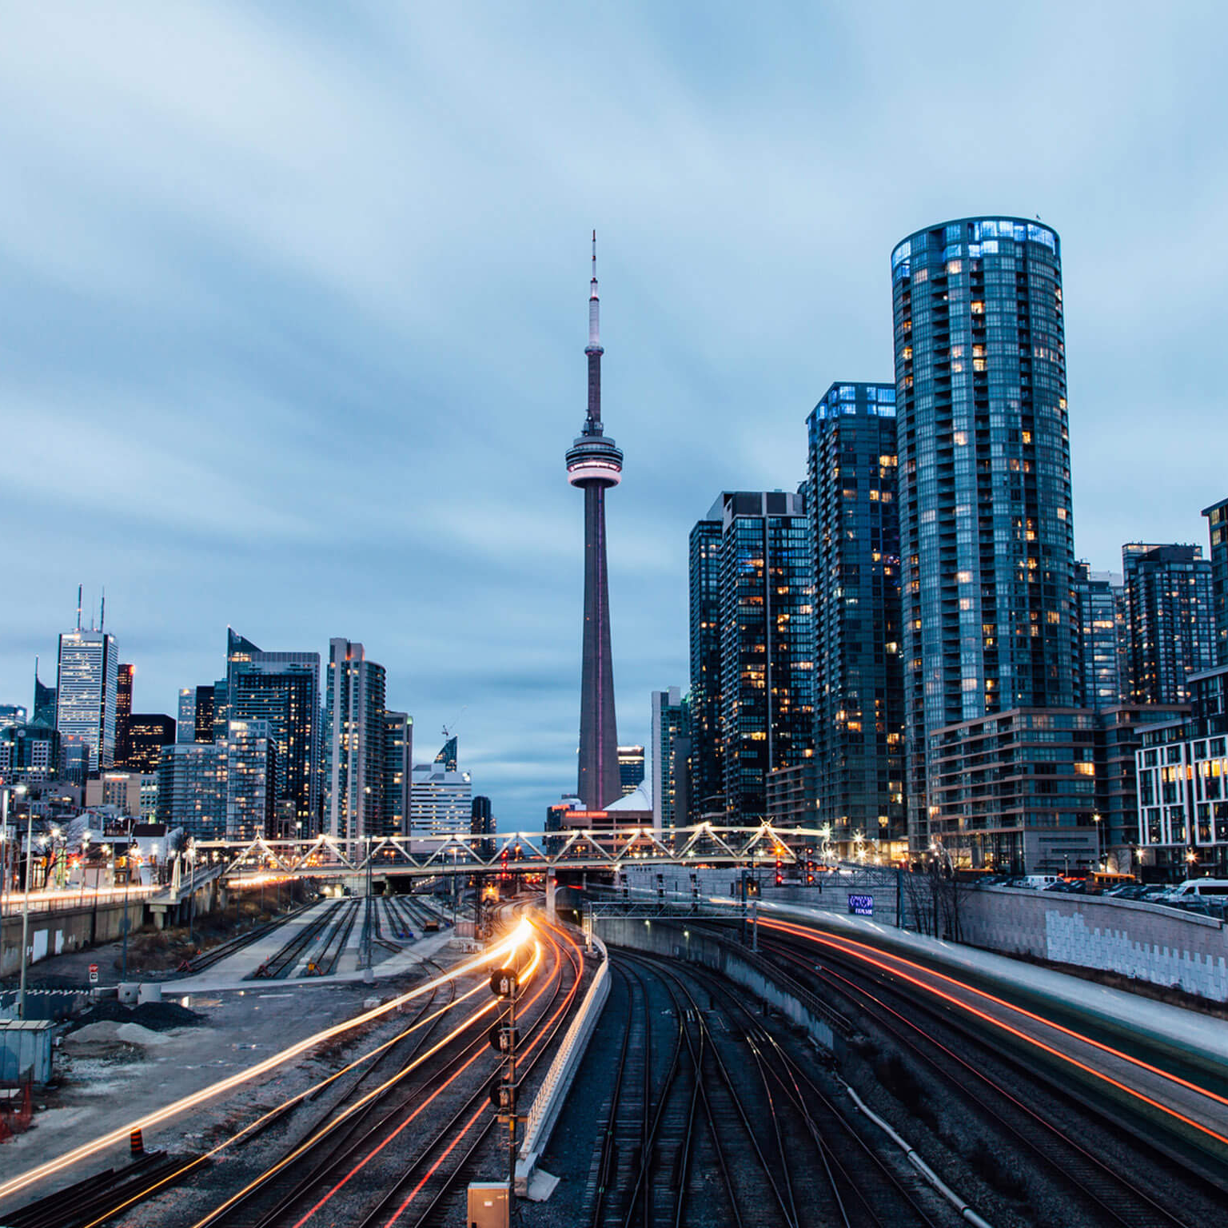
Data section
To solve this problem, we will need below data:
List of neighborhoods in Toronto, Canada
Longitude and latitude of these neighborhoods
Venue data related to Indian restaurants. This data will help in selecting the most suitable neighborhood to open an Indian restaurants
Getting latitude and longitude data of these neighborhoods using Geocoder package
Using foursquare API to get venue data related to these neighborhoods. We can filter these venues to get only Indian restaurants

Slide 5
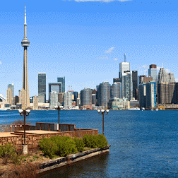
Methodology
First I need a list of all neighborhoods in Toronto, Canada. This is possible by extracting the list of neighborhoods from Wikipedia: https://en.wikipedia.org/wiki/List_of_postal_codes_of_Canada:_M,
Then, I need to get the coordinates of these neighborhoods to utilize foursquare to pull the list of venues near these neighborhoods. To get the coordinates, i used the geocoder package
Next, I use the foursquare API to pull the list of top 100 venues within 500 meters radius.
Here I made a justification to specifically look for “Indian restaurants”. Lastly I performed the clustering method by using k-means clustering algorithm. I have clustered the neighborhoods in Toronto into 3 clusters based on their frequency of occurrence for “Indian food”. Based on the results, I will be able to recommend a ideal location to the entrepreneur to open a restaurant

Slide 6
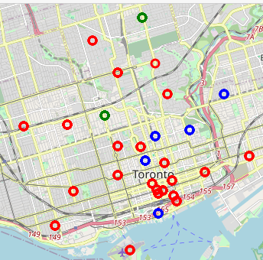


Result
CLUSTER 0
CLUSTER 1
Cluster 0 is represented by red color. According to this map, there are no Indian restaurants in these neighborhoods
Cluster 1 is represented by blue color. According to this map, cluster 1 has maximum number of Indian restaurants in these neighborhoods. So it will be difficult for a entrepreneur to open a restaurant in these neighborhoods

Slide 7
Result
CLUSTER 1
CLUSTER 2
Cluster 1 is represented by blue color. According to this map, cluster 1 has maximum number of Indian restaurants in these neighborhoods. So it will be difficult for a entrepreneur to open a restaurant in these neighborhoods
Cluster 2 is represented by green color. According to this map, cluster 3 has least number of Indian restaurants in these neighborhoods. So this cluster might be a good location as there are not much Indian restaurants in that area.

Slide 8
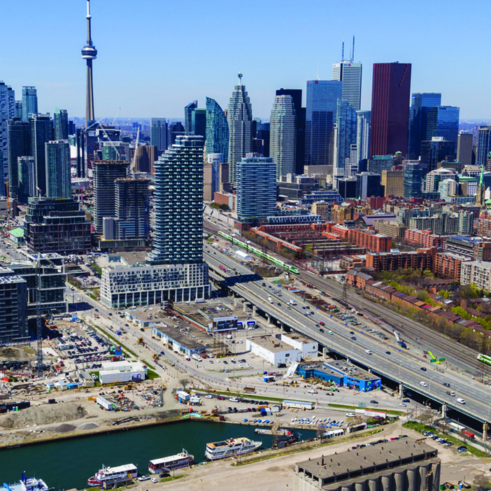
conclusion
Most of the Indian restaurants are in cluster 1 which is around St James Town, Church and Wellesley, Central Bay street, The Danforth West and Harbourfront East, lowest in cluster 2 areas which are in The Annex and Davisville
We can conclude from this project that cluster 1 has the maximum number of Indian restaurants in that area and any new entrepreneur can select cluster 2 location to open a authentic Indian restaurant

Slide 9
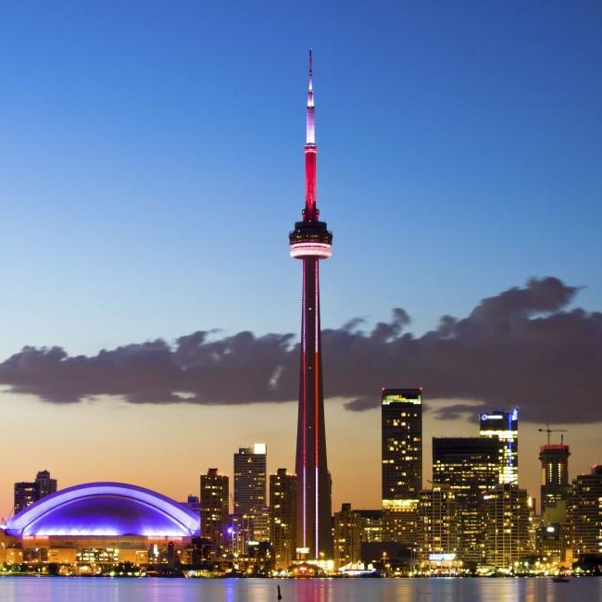
Thank you!
himanshu131198@gmail.com
https://github.com/himanshu345-sys/Coursera_Capstone/blob/master/data%20science%20project%20week%205th.ipynb

